Slide 1
The Pac-Man Projects
P0: UNIX/Python Tutorial
P1: Search
P2: Multi-Agent Search
P3: Reinforcement Learning
P4: BNs and HMMs: Ghostbusters
P5: Machine Learning: Classification

Slide 2
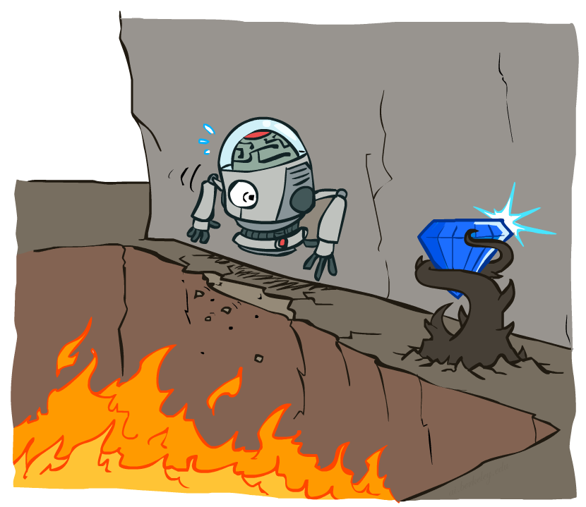
Non-Deterministic Search

Slide 3
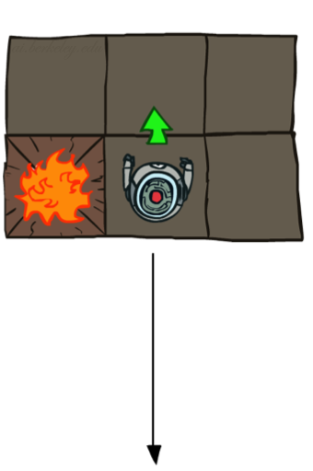
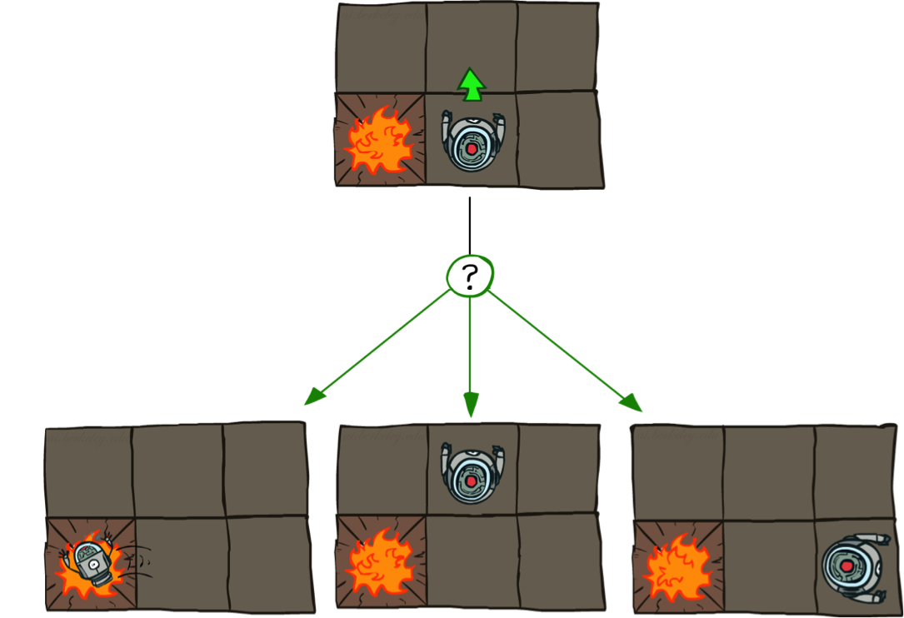

Grid World Actions
Deterministic Grid World
Stochastic Grid World

Slide 4





Markov Decision Processes
An MDP is defined by:
A set of states s ∈ S
A set of actions a ∈ A
A transition function T(s, a, s’)
Probability that a from s leads to s’, i.e., P(s’| s, a)
Also called the model or the dynamics
A reward function R(s, a, s’)
Sometimes just R(s) or R(s’)
A start state
Maybe a terminal state
MDPs are non-deterministic search problems
One way to solve them is with expectimax search
We’ll have a new tool soon
[Demo – gridworld manual intro (L8D1)]
Notes:
In search problems: did not talk about actions, but about successor functions --- now the information inside the successor function is unpacked into actions, transitions and reward
Write out S, A, example entry in T, entry in R
Reward function different from the book : R(s,a,s’)
In book simpler for equations, but not useful for the projects.
Need to modify expectimax a tiny little bit to account for rewards along the way, but that’s something you should be able to do, and so you can already solve MDP’s (not in most efficient way)

Slide 5
MDPs
http://inst.cs.berkeley.edu/~cs188/sp20/project3/#mdps

Slide 6

Policies
In deterministic single-agent search problems, we wanted an optimal plan, or sequence of actions, from start to a goal
For MDPs, we want an optimal policy π*: S → A
A policy π gives an action for each state
An optimal policy is one that maximizes expected utility if followed
An explicit policy defines a reflex agent
Expectimax didn’t compute entire policies
It computed the action for a single state only
Optimal policy when R(s, a, s’) = -0.03 for all non-terminals s
Notes:
Dan has a DEMO for this.

Slide 7
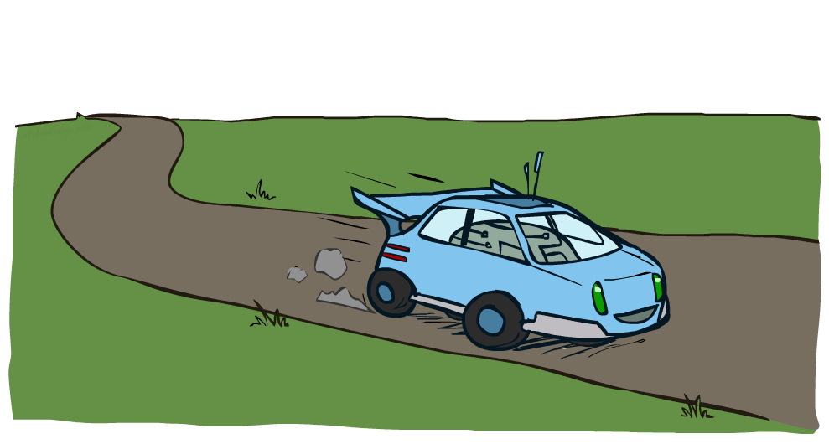
Example: Racing

Slide 8
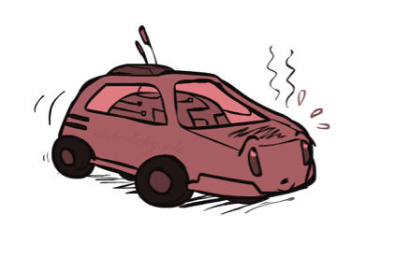
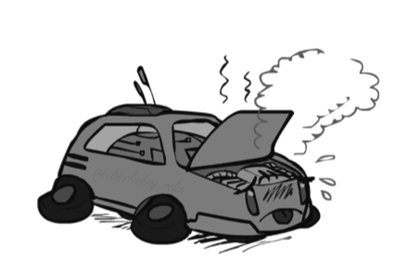

Example: Racing
A robot car wants to travel far, quickly
Three states: Cool, Warm, Overheated
Two actions: Slow, Fast
Going faster gets double reward
0.5
+1
1.0
Fast
Slow
-10
+1
0.5
Warm
Slow
Fast
0.5
+2
Cool
0.5
Overheated
+1
1.0
+2

Slide 9


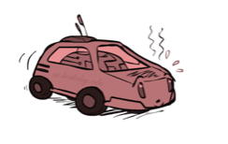
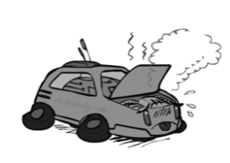
Racing Search Tree

Slide 10
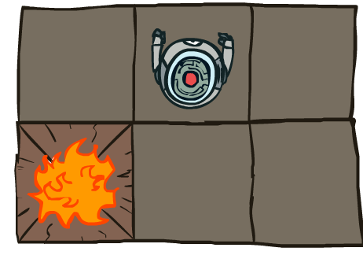


MDP Search Trees
Each MDP state projects an expectimax-like search tree
s
s is a state
a
(s, a) is a q-state
s, a
(s,a,s’) called a transition
T(s,a,s’) = P(s’|s,a)
R(s,a,s’)
s,a,s’
s’
Notes:
In MDP chance node represents uncertainty about what might happen based on (s,a) [as opposed to being a random adversary]
Q-state (s,a) is when you were in a state and took an action

Slide 11




Discounting
It’s reasonable to maximize the sum of rewards
It’s also reasonable to prefer rewards now to rewards later
One solution: values of rewards decay exponentially
Worth Now
Worth Next Step
Worth In Two Steps

Slide 12

Discounting
How to discount?
Each time we descend a level, we multiply in the discount once
Why discount?
Sooner rewards probably do have higher utility than later rewards
Also helps our algorithms converge
Example: discount of 0.5
U([1,2,3]) = 1*1 + 0.5*2 + 0.25*3
U([1,2,3]) < U([3,2,1])
Notes:
Rewards in the future (deeper in the tree) matter less
Interesting: running expectimax, if having to truncate the search, then not losing much; e.g., less then \gamma^d / (1-\gamma)

Slide 13
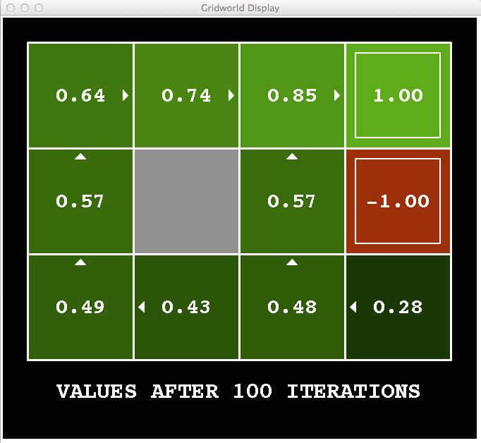
Snapshot of Demo – Gridworld V Values
Noise = 0.2
Discount = 0.9
Living reward = 0
Notes:
This demo doesn’t show anything in action, it just shows the V and Q values.

Slide 14
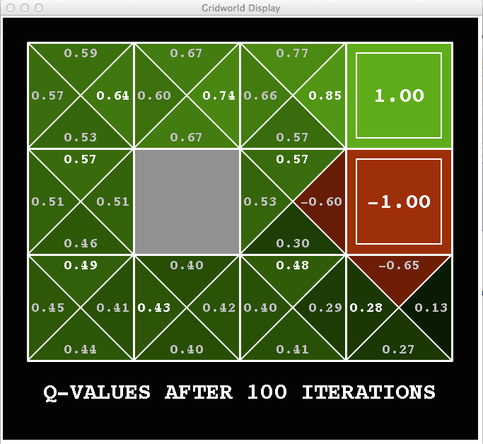
Snapshot of Demo – Gridworld Q Values
Noise = 0.2
Discount = 0.9
Living reward = 0
Notes:
This demo doesn’t show anything in action, it just shows the V and Q values.

Slide 15


Values of States
Fundamental operation: compute the (expectimax) value of a state
Expected utility under optimal action
Average sum of (discounted) rewards
This is just what expectimax computed!
Recursive definition of value:
s
a
s, a
s,a,s’
s’

Slide 16
Value Iteration
Start with V₀(s) = 0: no time steps left means an expected reward sum of zero
Given vector of V_{k}(s) values, do one ply of expectimax from each state:
Repeat until convergence
Complexity of each iteration: O(S²A)
Theorem: will converge to unique optimal values
Basic idea: approximations get refined towards optimal values
Policy may converge long before values do
V_{k+1}(s)
a
s, a
s,a,s’
V_{k}(s’)
Notes:
Discuss computational complexity: S * A * S times number of iterations
Note: updates not in place [if in place, it means something else and not even clear what it means]

Slide 17
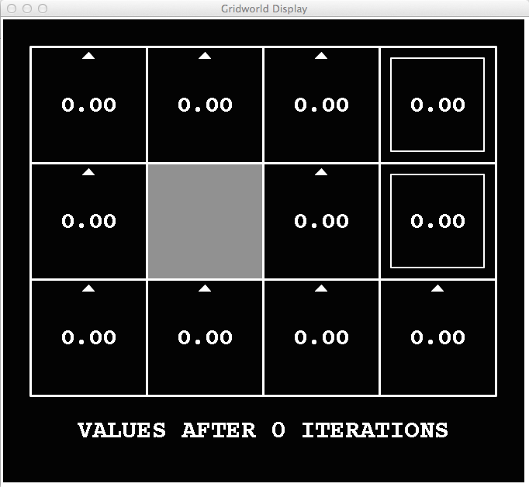
k=0
Noise = 0.2
Discount = 0.9
Living reward = 0
Notes:
Assuming zero living reward

Slide 18
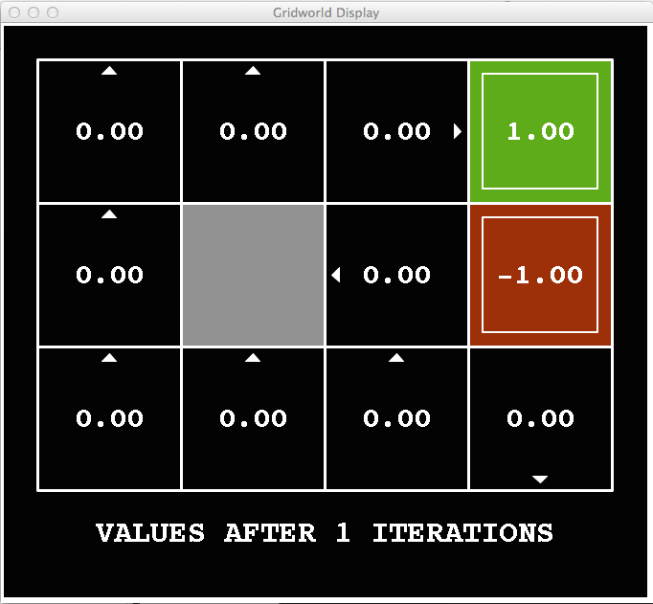
k=1
Noise = 0.2
Discount = 0.9
Living reward = 0
Notes:
Assuming zero living reward

Slide 19
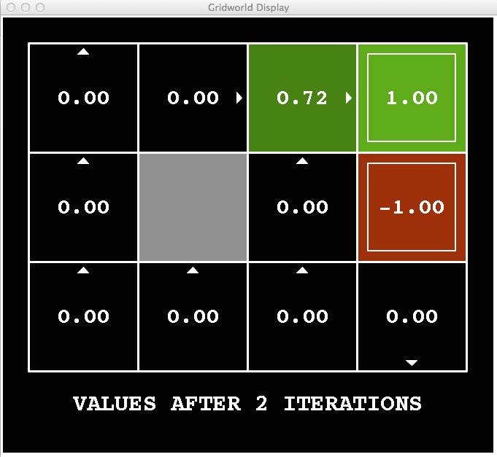
k=2
Noise = 0.2
Discount = 0.9
Living reward = 0
Notes:
Assuming zero living reward

Slide 20
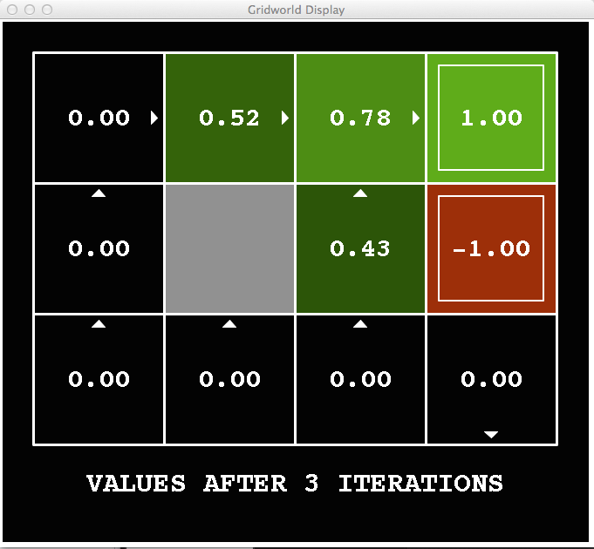
k=3
Noise = 0.2
Discount = 0.9
Living reward = 0
Notes:
Assuming zero living reward

Slide 21
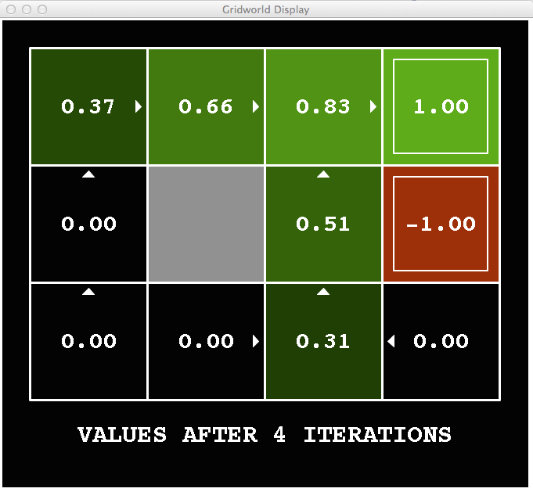
k=4
Noise = 0.2
Discount = 0.9
Living reward = 0
Notes:
Assuming zero living reward

Slide 22
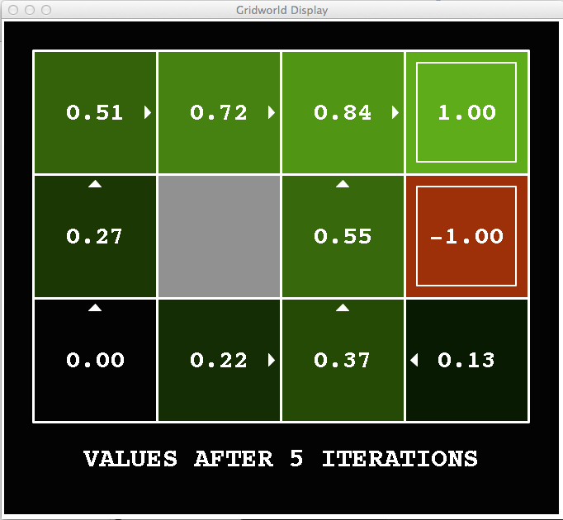
k=5
Noise = 0.2
Discount = 0.9
Living reward = 0
Notes:
Assuming zero living reward

Slide 23
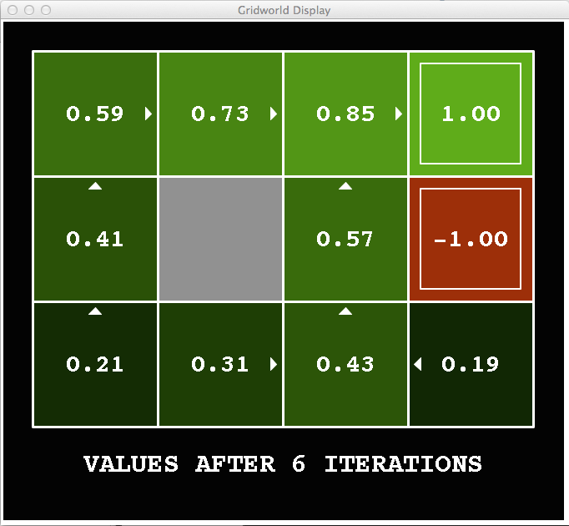
k=6
Noise = 0.2
Discount = 0.9
Living reward = 0
Notes:
Assuming zero living reward

Slide 24
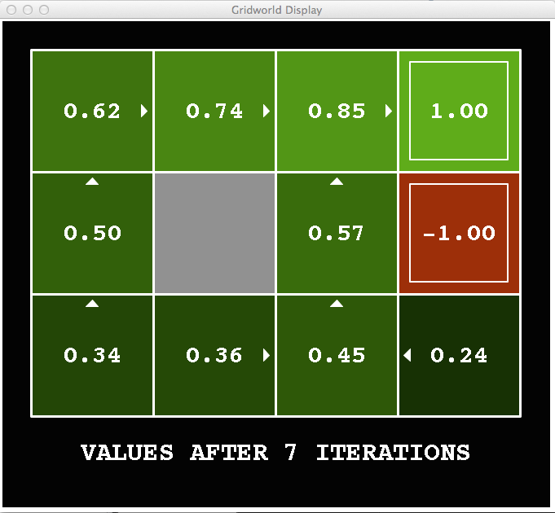
k=7
Noise = 0.2
Discount = 0.9
Living reward = 0
Notes:
Assuming zero living reward

Slide 25
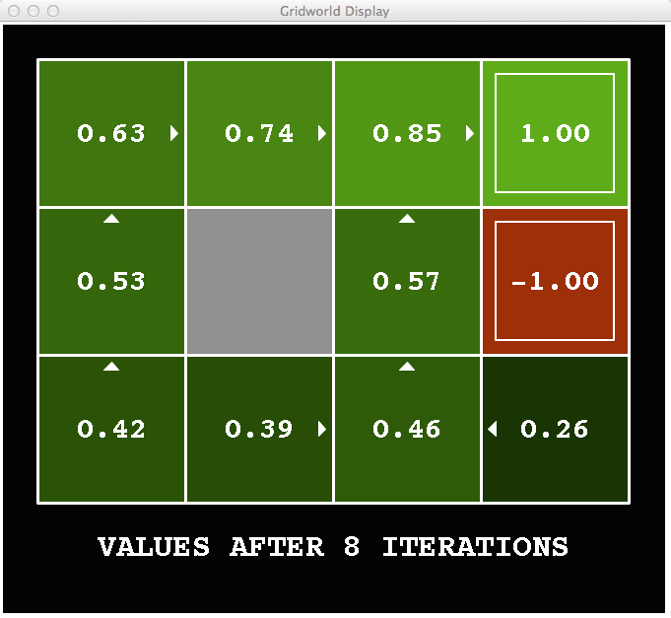
k=8
Noise = 0.2
Discount = 0.9
Living reward = 0
Notes:
Assuming zero living reward

Slide 26
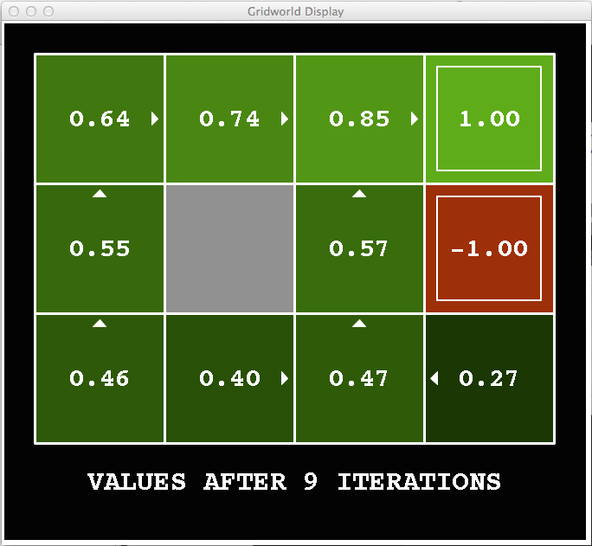
k=9
Noise = 0.2
Discount = 0.9
Living reward = 0
Notes:
Assuming zero living reward

Slide 27

k=10
Noise = 0.2
Discount = 0.9
Living reward = 0
Notes:
Assuming zero living reward

Slide 28

k=11
Noise = 0.2
Discount = 0.9
Living reward = 0
Notes:
Assuming zero living reward

Slide 29

k=12
Noise = 0.2
Discount = 0.9
Living reward = 0
Notes:
Assuming zero living reward

Slide 30

k=100
Noise = 0.2
Discount = 0.9
Living reward = 0
Notes:
收敛

Slide 31
Question 1 (4 points): Value Iteration
http://inst.cs.berkeley.edu/~cs188/sp20/project3/#question-1-4-points-value-iteration

Slide 32
Question 2 (1 point): Bridge Crossing Analysis
http://inst.cs.berkeley.edu/~cs188/sp20/project3/#question-2-1-point-bridge-crossing-analysis

Slide 33
Question 3 (5 points): Policies
http://inst.cs.berkeley.edu/~cs188/sp20/project3/#question-3-5-points-policies

Slide 34

Policy Evaluation

Slide 35
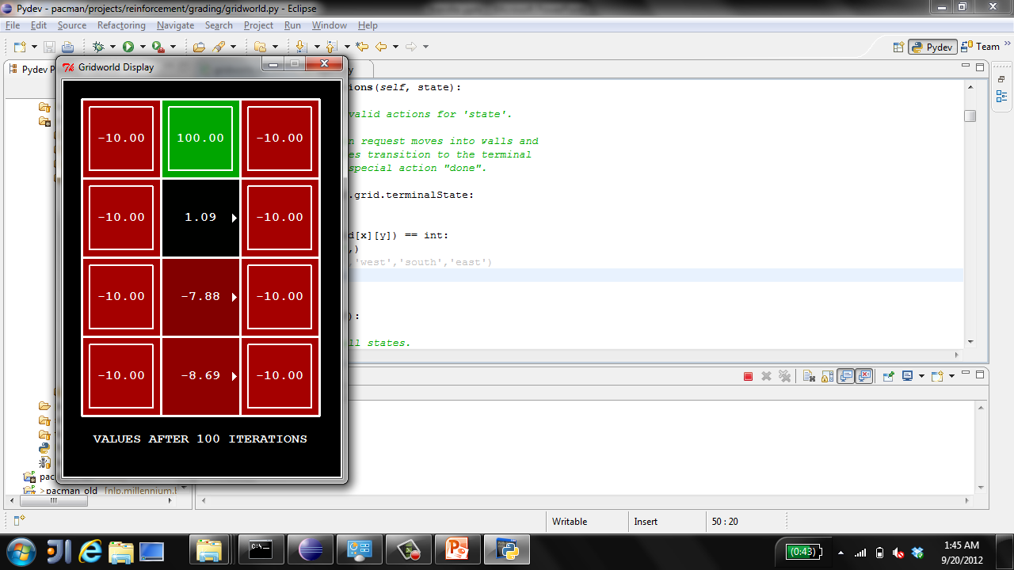
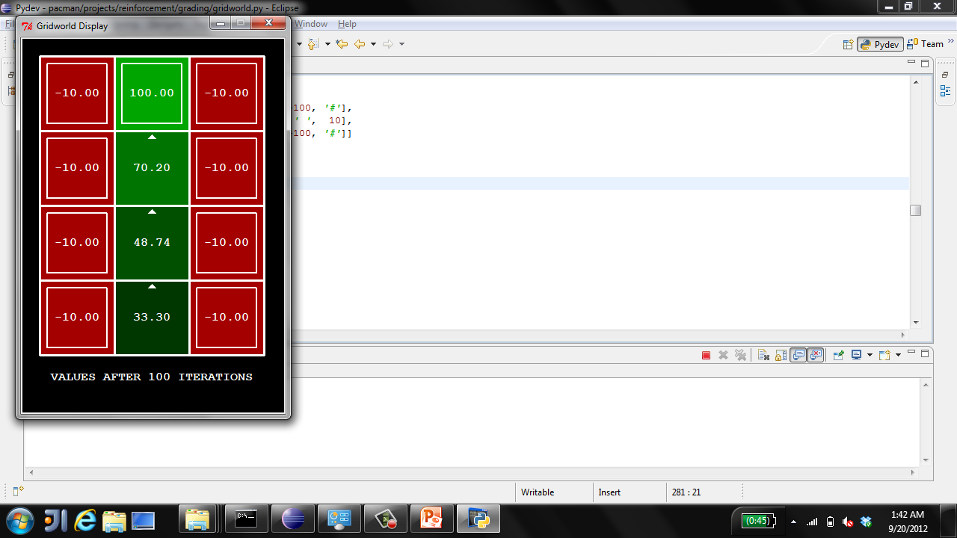
Example: Policy Evaluation
Always Go Right
Always Go Forward

Slide 36
Policy Iteration
Evaluation: For fixed current policy π, find values with policy evaluation:
Iterate until values converge:
Improvement: For fixed values, get a better policy using policy extraction
One-step look-ahead:

Slide 37
Comparison
Both value iteration and policy iteration compute the same thing (all optimal values)
In value iteration:
Every iteration updates both the values and (implicitly) the policy
We don’t track the policy, but taking the max over actions implicitly recomputes it
In policy iteration:
We do several passes that update utilities with fixed policy (each pass is fast because we consider only one action, not all of them)
After the policy is evaluated, a new policy is chosen (slow like a value iteration pass)
The new policy will be better (or we’re done)
Both are dynamic programs for solving MDPs

Slide 38
Question 4 (1 point): Asynchronous Value Iteration
http://inst.cs.berkeley.edu/~cs188/sp20/project3/#question-4-1-point-asynchronous-value-iteration

Slide 39
Question 5 (3 points): Prioritized Sweeping Value Iteration
http://inst.cs.berkeley.edu/~cs188/sp20/project3/#question-5-3-points-prioritized-sweeping-value-iteration

Slide 40

Reinforcement Learning

Slide 41
Reinforcement Learning
Agent
State: s
Reward: r
Actions: a
Environment
Basic idea:
Receive feedback in the form of rewards
Agent’s utility is defined by the reward function
Must (learn to) act so as to maximize expected rewards
All learning is based on observed samples of outcomes!
Notes:
Show robot-soccer learning to walk videos (UT Austin):
? Show snake robot:

Slide 42
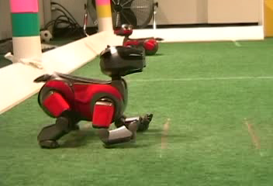

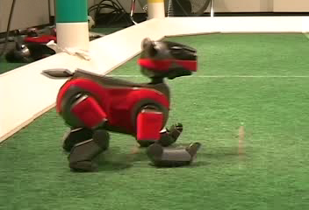
Example: Learning to Walk
Initial
A Learning Trial
After Learning [1K Trials]
[Kohl and Stone, ICRA 2004]

Slide 43
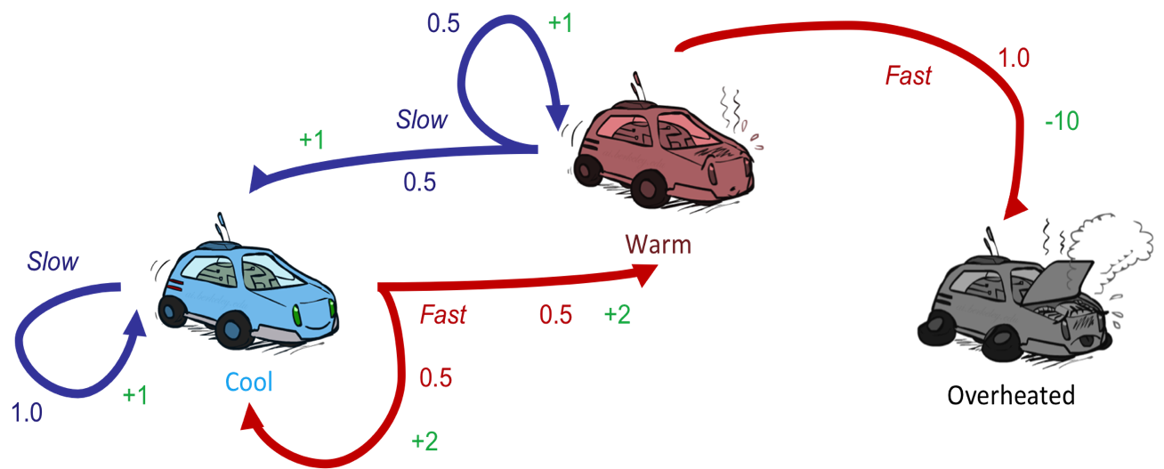
Reinforcement Learning
Still assume a Markov decision process (MDP):
A set of states s ∈ S
A set of actions (per state) A
A model T(s,a,s’)
A reward function R(s,a,s’)
Still looking for a policy π(s)
New twist: don’t know T or R
I.e. we don’t know which states are good or what the actions do
Must actually try out actions and states to learn

Slide 44
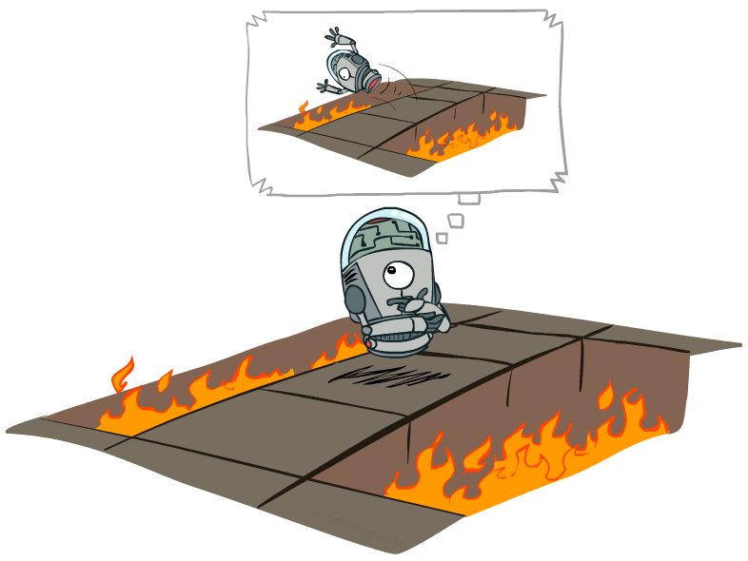
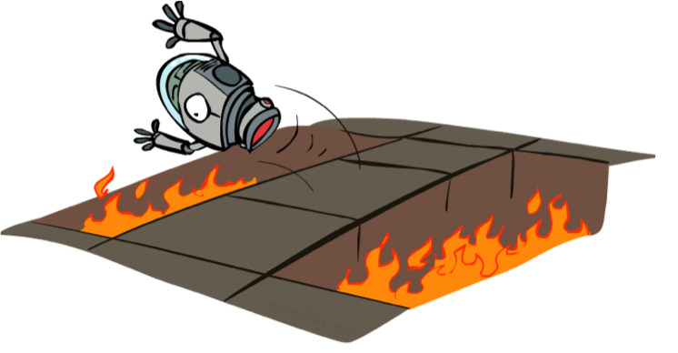
Offline (MDPs) vs. Online (RL)
Offline Solution
Online Learning

Slide 45
Offline (MDPs) vs. Online (RL)
Offline Solution
Online Learning

Slide 46
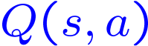
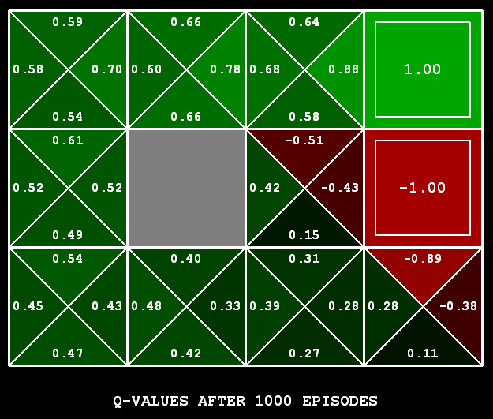
Q-Learning
Q-Learning: sample-based Q-value iteration
Learn Q(s,a) values as you go
Receive a sample (s,a,s’,r)
Consider your old estimate:
Consider your new sample estimate:
Incorporate the new estimate into a running average:
[Demo: Q-learning – gridworld (L10D2)]
[Demo: Q-learning – crawler (L10D3)]

Slide 47
Question 6 (4 points): Q-Learning
http://inst.cs.berkeley.edu/~cs188/sp20/project3/#question-6-4-points-q-learning

Slide 48

How to Explore?
Several schemes for forcing exploration
Simplest: random actions (ε-greedy)
Every time step, flip a coin
With (small) probability ε, act randomly
With (large) probability 1-ε, act on current policy
Problems with random actions?
You do eventually explore the space, but keep thrashing around once learning is done
One solution: lower ε over time
Another solution: exploration functions
[Demo: Q-learning – manual exploration – bridge grid (L11D2)] [Demo: Q-learning – epsilon-greedy -- crawler (L11D3)]

Slide 49
Question 7 (2 points): Epsilon Greedy
http://inst.cs.berkeley.edu/~cs188/sp20/project3/#question-7-2-points-epsilon-greedy

Slide 50
Question 8 (1 point): Bridge Crossing Revisited
http://inst.cs.berkeley.edu/~cs188/sp20/project3/#question-8-1-point-bridge-crossing-revisited

Slide 51
Question 9 (1 point): Q-Learning and Pacman
http://inst.cs.berkeley.edu/~cs188/sp20/project3/#question-9-1-point-q-learning-and-pacman

Slide 52

Approximate Q-Learning
Notes:
In a realistic situation, there are too many states and actions,
so we cannot learn every single state-action pair. It is too slow
to learn the Q value of each state and action individually.

Slide 53
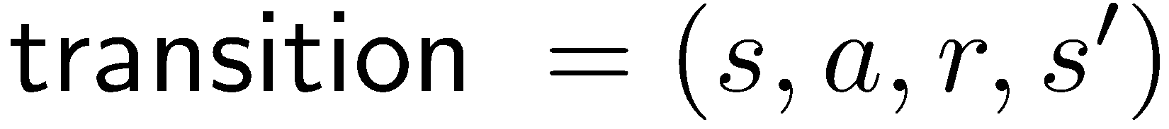
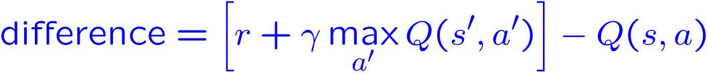
Approximate Q-Learning
Q-learning with linear Q-functions:
Intuitive interpretation:
Adjust weights of active features
E.g., if something unexpectedly bad happens, blame the features that were on: disprefer all states with that state’s features
Formal justification: online least squares
Exact Q’s
Approximate Q’s

Slide 54
Question 10 (3 points): Approximate Q-Learning
http://inst.cs.berkeley.edu/~cs188/sp20/project3/#question-10-3-points-approximate-q-learning

Slide 55

RL: Helicopter Flight
[Andrew Ng]
[Video: HELICOPTER]

Slide 56
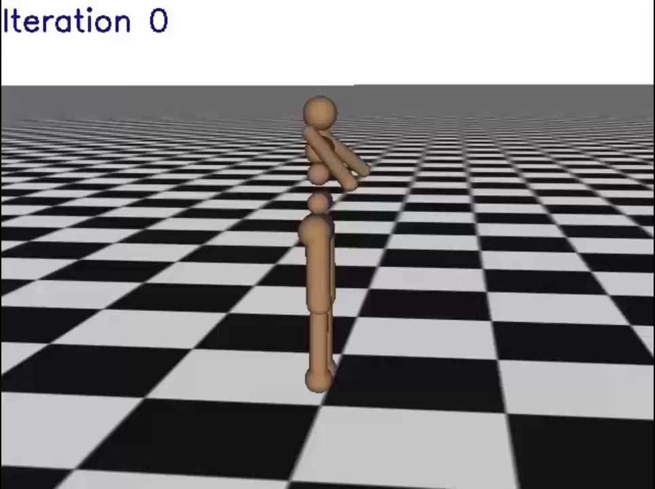
RL: Learning Locomotion
[Schulman, Moritz, Levine, Jordan, Abbeel, ICLR 2016]
[Video: GAE]

